Slide 1
Physics-Informed Reconstruction of Cylinder Flow with Reynolds Continuation
PINN-based reconstruction and transition analysis for 2D incompressible flow past a cylinder
Junhe Chen
Spring 2026

Slide 3
Project Overview
Physical problem, objectives, and expected transition behavior
Problem Statement
Main Deliverables
2D incompressible flow past a circular cylinder is a canonical benchmark in fluid dynamics.
As Reynolds number increases, the wake evolves from steady symmetric recirculation to time-periodic vortex shedding.
This project uses a Physics-Informed Neural Network (PINN) to reconstruct the flow field and study the transition region.
Flow reconstruction
Velocity, pressure, vorticity, and streamlines
Reusable pipeline
Continuation training across Reynolds numbers
Geometry and setup
Cylinder radius R = 0.5
Domain x in [-5, 25], y in [-10, 10]
Target Reynolds sweep: Re = 5 to 100

Slide 4
Governing Equations and PINN Formulation
2D incompressible Navier-Stokes with stream-function parameterization
Navier-Stokes Equations
Stream Function Form
u_t + u u_x + v u_y = -p_x + (1/Re)(u_xx + u_yy)
v_t + u v_x + v v_y = -p_y + (1/Re)(v_xx + v_yy)
u_x + v_y = 0
Represent the solution as
psi(x, y, t), p(x, y, t)
u = d psi / d y
v = - d psi / d x
The PINN minimizes PDE residuals together with boundary, initial, and outlet constraints using automatic differentiation.
Enforces incompressibility by construction.
Removes the need for an extra divergence penalty term.
Produces smooth derivatives compatible with PDE residual evaluation.

Slide 5
Network Architecture, Training, and Loss Design
Model Architecture
Loss Function
Sampling Strategy
(x, y, t) --> MLP --> (psi, p)
L = L_pde + 10 L_bc + 10 L_ic + L_out
Physics-aware collocation
Width
128 neurons/layer
PDE loss: momentum residuals from Navier-Stokes.
Boundary loss: inlet, wall, and far-field conditions.
Initial loss: uniform initialization in the domain.
Outlet loss: pressure / gradient regularization downstream.
50%
30%
20%
Depth
6 hidden layers
Refine points near the cylinder to capture boundary-layer behavior.
Bias sampling in the wake to resolve separation and shedding.
Use smoother activation and derivatives for stable AD-based training.
Activation
tanh
Optimizer
Adam + L-BFGS

Slide 6
Reynolds Continuation Strategy
Warm-starting across Reynolds numbers to improve optimization stability
Continuation Workflow
Re = 5
Re = 40
Re = 40-60
Re = 61-100
Initialize low-Re steady solution
Transfer weights and continue training
Resolve transition region carefully
Track increasingly unsteady wake dynamics
More stable optimization
Fewer iterations at each new Re
Better continuity across the parameter sweep

Slide 7
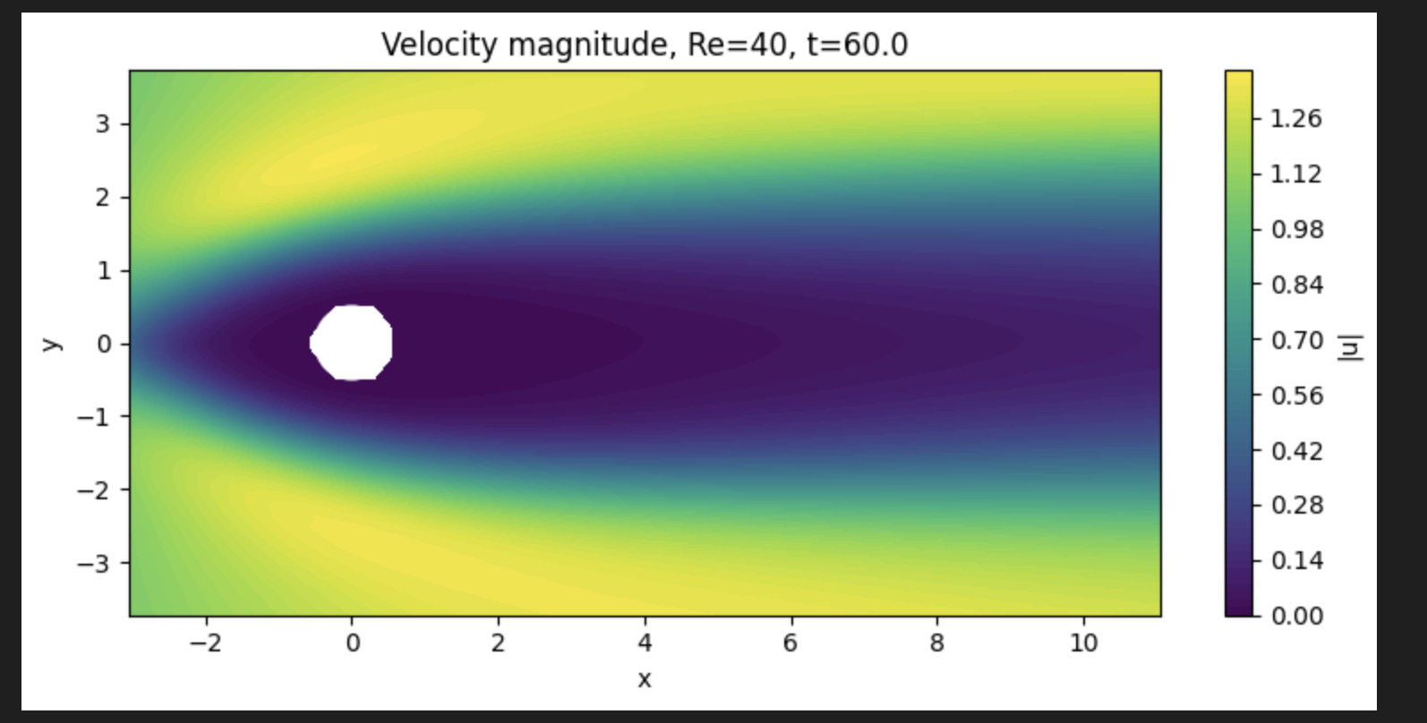
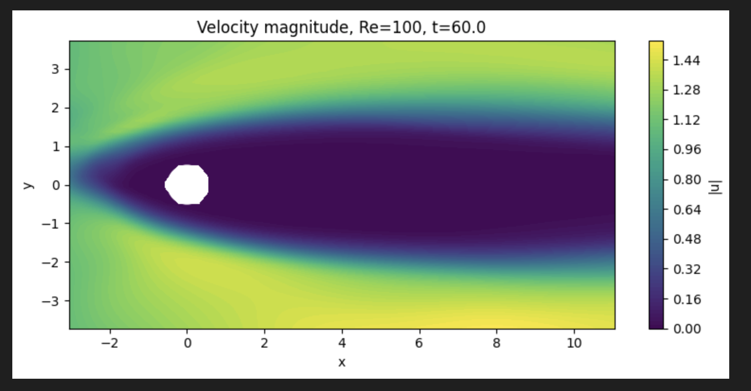
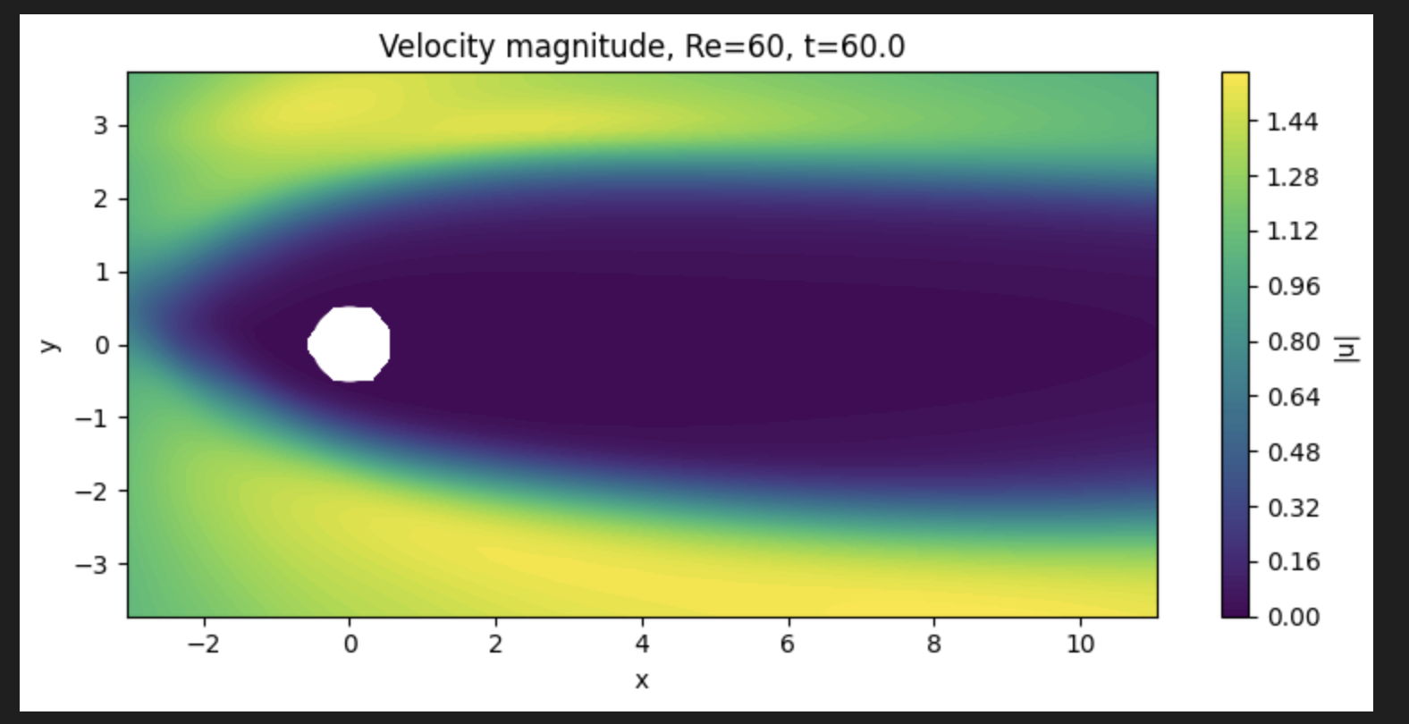
Results Placeholder: Flow Reconstruction
Replace placeholder panels with your exported figures
Key observations
Velocity magnitude should show stagnation at the front face and acceleration near the cylinder sides.
Downstream recovery and recirculation bubble length can be compared across Reynolds numbers.
Use the same colorbar range when comparing multiple Re values.
Recommended figures
• Velocity magnitude contour at representative times
• Streamline plot showing wake topology
• Optional comparison: Re = 40, 60, 100

Slide 10
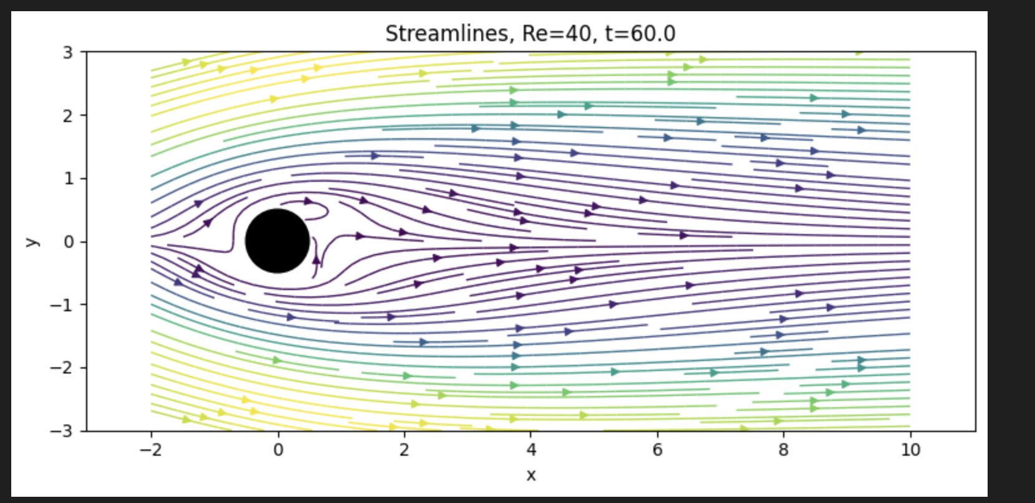

Slide 11
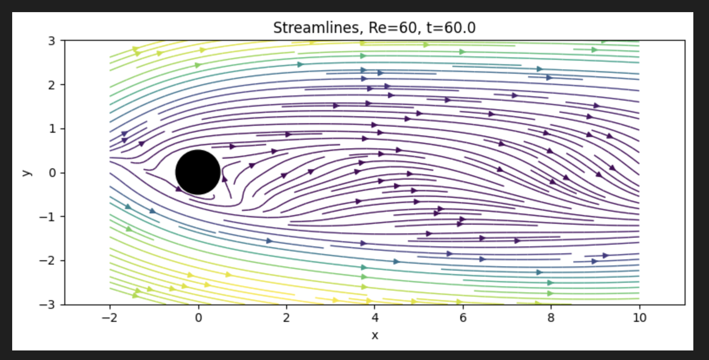

Slide 12
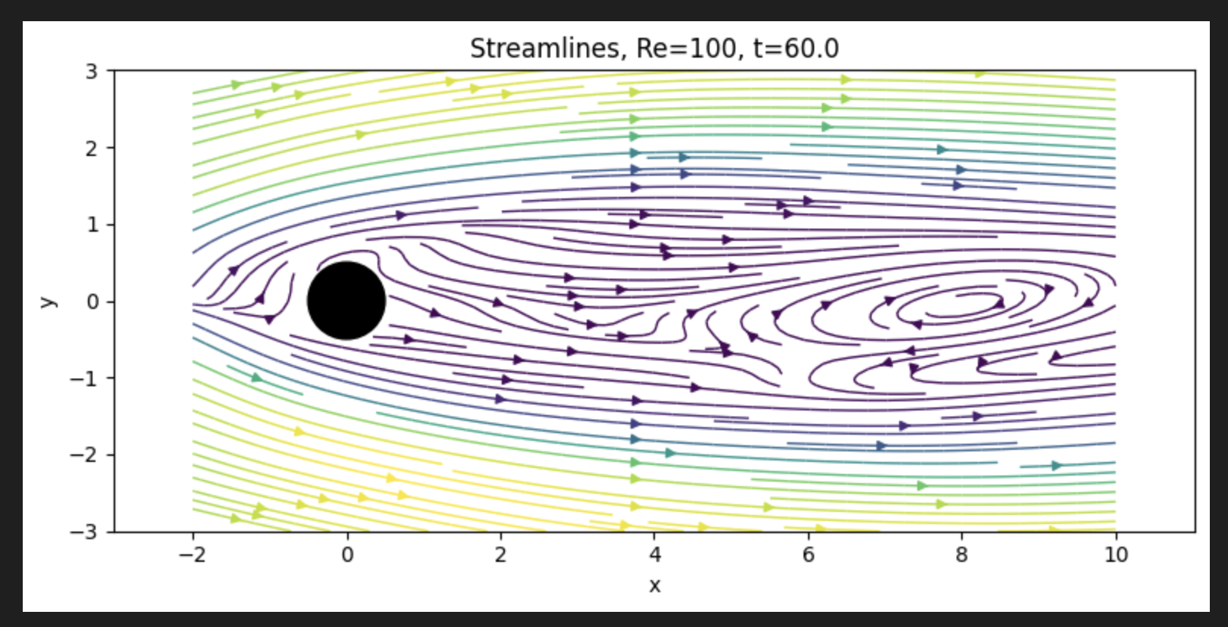

Slide 13
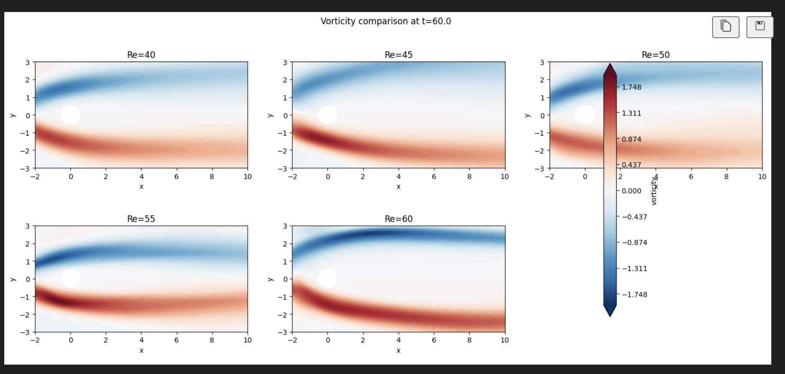
Results Placeholder: Vorticity and Probe Signals
Use these for wake structure and time-series evidence of transition

Slide 14
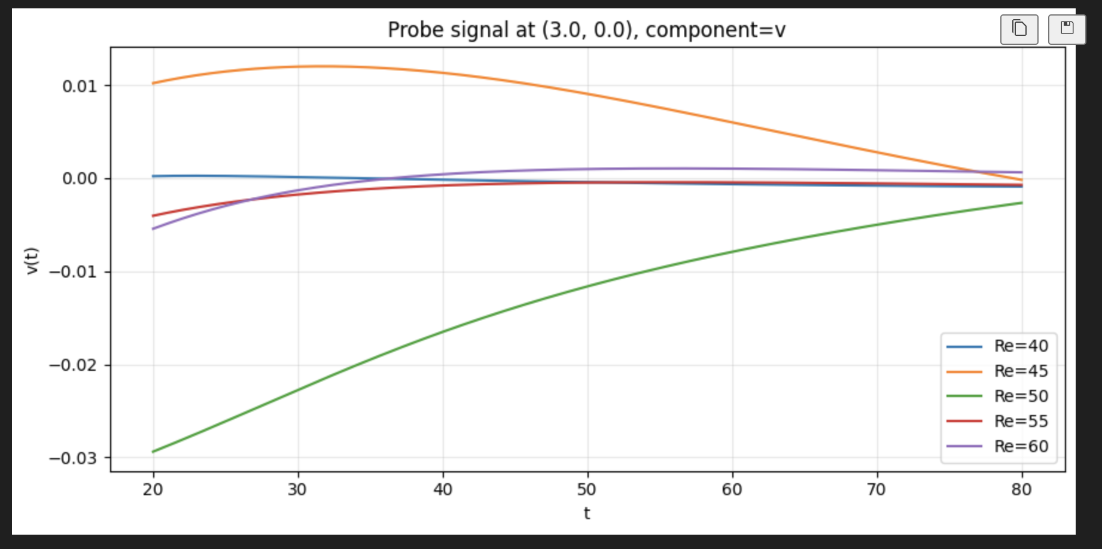

Slide 15
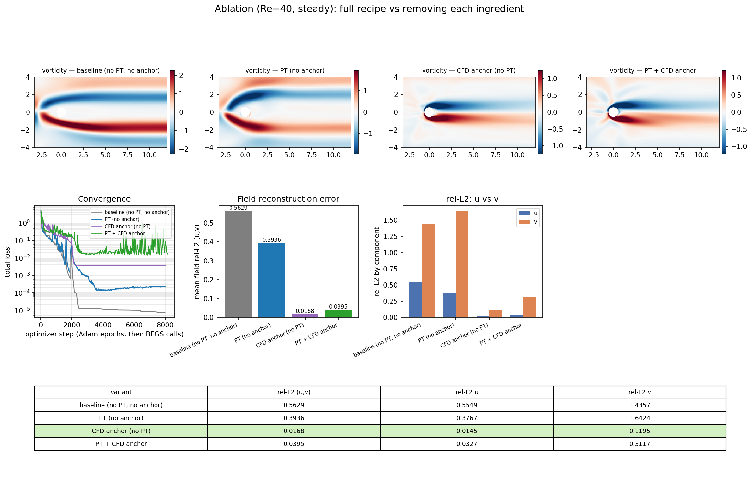
Ablation: pseudo-time (PT) x CFD data anchor (Re=40, steady)
Takeaway: the CFD data anchor is the dominant lever (rel-L2 0.017). Physics-only PINNs reach the lowest training loss yet the worst field -- a spurious wake.

Slide 16
What the 2x2 shows, and how to reach ground truth
Key findings
CFD data anchor is decisive: field rel-L2 (u,v) 0.56 -> 0.017. Best cell = anchor, NO PT.
Physics-only PINN (no anchor) finds a SPURIOUS wake: lowest training loss (7e-6) but worst field (0.56).
PT helps only without data: 0.56 -> 0.39 (avoids the spurious solution, per Wang et al. 2026) -- but still far from truth.
PT + anchor was WORSE than anchor alone (0.040 vs 0.017): PT weight saturated at the ceiling and fought the data.
Next steps -> full field ~ ground truth
1. Keep the full-field CFD anchor -- it is what gets you to ~1.7%. This is the working config.
2. Fix the wake / v-component (rel-L2 v still 0.12): add Fourier features + hard BCs (cfp40_v2), and more collocation + data in the near wake.
3. Anchor pressure (pMean) too, not just u/v, for the full physical field.
4. Drop PT in the data-supervised setting; reserve PT for data-free / forward solves. If kept, widen w_max and let the gamma shrink activate.
5. Tighter convergence: longer BFGS or the two-stage recipe (data-only pretrain -> PDE on).

Slide 17
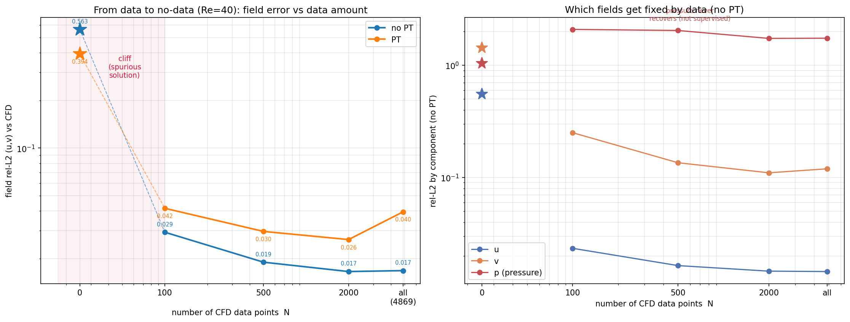
How little data does Re=40 need? (data -> no-data)
~100 random CFD points collapse the field error from 0.56 (data-free) to ~0.03: the data->no-data transition is a CLIFF, not a ramp. Beyond ~100 points, more data barely helps velocity.
PT helps ONLY at exactly N=0. With ANY data, plain PINN (no PT) wins at every level -- PT's relaxation fights the data.
Pressure never recovers at any N (it is not supervised) -- it needs its own anchor.

Slide 18
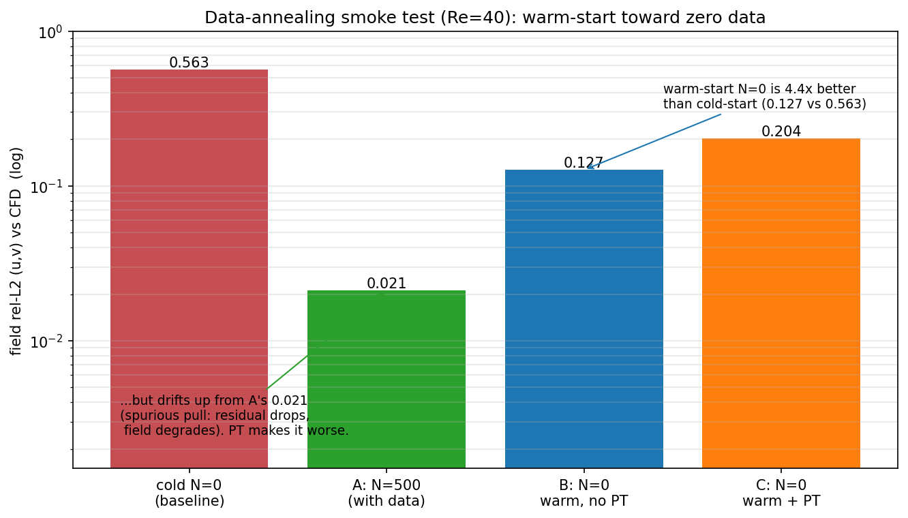
Warm-start annealing toward zero data (Re=40)
Verdict: promising direction, but zero-data is genuinely hard
Warm-starting N=0 from a correct low-data solution -> 0.127, 4.4x better than cold-start (0.563). So the annealing direction has real value.
But it drifts up from A's 0.021: once data is removed, the optimizer slides toward the spurious solution -- PDE residual DROPS (0.012->0.005) while the field DEGRADES. Classic low-residual-wrong-field.
Faithful PT did NOT rescue it (0.204, worse than no-PT). PT is not the fix here.
Next: gradual ladder (500->250->100->50->0) -- smaller steps may hold lower than the single 500->0 jump; find the data floor.

